Slide 1
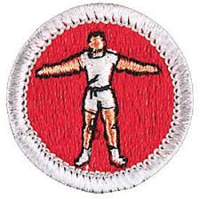
Personal Fitness
Merit Badge
Scouts BSA

Slide 2
Safety
Follow your family’s rules for going online
Protect your privacy
Do not open emails or files from people you do not know or trust
If you receive/discover information that makes you uncomfortable, leave it and tell your parents
Do not believe everything you see or read online
NEVER agree to get together with someone you “meet” online
NEVER give personal information like email, phone number, address
NEVER share your Internet passwords with anyone
NEVER shop online unless you have your parent’s permission to do so
Be a good online citizen

Slide 3
Requirement 1
Physical Exam by PCP, primary care provider.
Describe the exam and interview
Describe health recommendations the PCP made and what you have done in response
Explain the following
Why are physical exams important
Why preventative habits (such as exercising regularly) are important in maintaining good health, and how the use of tobacco products, alcohol, and other harmful substances can negatively affect your personal fitness
Diseases that can be prevented and how
Seven warning signs of cancer
Youth risk factors that affect cardiovascular fitness in adulthood
Dental Exam
Proof that teeth have been checked
Tell how to care for your teeth

Slide 4
Requirement 1
Physical Exam by PCP, primary care provider.
Describe the exam and interview
Personal medical history (chronic illness and surgical history)
Family medical history
Allergies
Medications
Record: health history, growth pattern, immunizations
Lifestyle: hours of sleep/exercise, type of foods you eat, what do you do for fun, how is school, do you have any friends, how is your relationship with your parents
Physical exam: Heart rate, blood pressure, height, weight, heart and lung sounds, ears, mouth, throat, eye exam, reflexes, signs of puberty, overall general health
Describe health recommendations the PCP made and what you have done in response

Slide 5
Requirement 1
Physical Exam by PCP, primary care provider.
Explain the following
Why are physical exams important
Develop relationship with provider
Advice for preventative care: immunizations, diet/exercise recommendation
Screen for chronic illness
Review medications and supplements
Track general health and growth
Ask questions about lifestyle and health habits

Slide 6
Requirement 1
Physical Exam by PCP, primary care provider.
Why preventative habits (such as exercising regularly) are important in maintaining good health, and how the use of tobacco products, alcohol, and other harmful substances can negatively affect your personal fitness
Preventative habits
Regular exercise
Good nutrition
Regular sleep
Spending time with family/friends
Studying/reading
Hobbies

Slide 7
Requirement 1
Regular exercise
30-60 minutes daily
Good nutrition
Eat a balanced diet appropriate for lifestyle
Regular sleep
Renewed energy
9-10 hours each night
Plan schedule to go to bed at same time every night and wake up at same time every morning
Exercise > 3 hours before bed
Avoid heavy meals, spicy foods, caffeine, sugary food/drinks in the evening
No electronics (TV, phone, computer) 2 hours prior to sleep

Slide 8
Requirement 1
Limit screen time
Recommended no more than 2 hours daily
Spending time with family/friends
Building social bonds
Studying/reading
Exercising/expanding your mind
Hobbies
Relax, increase confidence, make friends, creative outlet

Slide 9
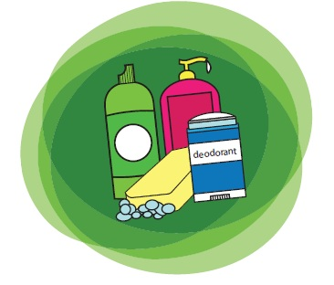
Requirement 1
Hygiene/Body Care
Bathe regularly. Depending on skin type and activity level- daily, every other day.
SPF 30+ daily, especially for your face
Sunglasses, broad-brimmed hat
Deodorant/Antiperspirant

Slide 10
Requirement 1
Hygiene/Body Care
Avoid using chemicals, noxious odors in poorly ventilated spaces
Eyes
Annual exam
Wear goggles for safety and swimming, and rest eyes when using computer
Ears
Listen to music at reasonable volume
Wear protection around machinery and firing ranges

Slide 11
Requirement 1
PREVENTION
Wear safety equipment when using machinery, and during recreation
Helmets, joint pads, seatbelt, gloves, safety glasses
Wash hands frequently, use hand sanitizer
Especially after bathroom use, before handling food, and after handling animals
Avoid close contact with visibly ill people
Dress appropriately for the weather
Cover your mouth when sneezing/coughing
Immunization up-to-date, including flu shot

Slide 12
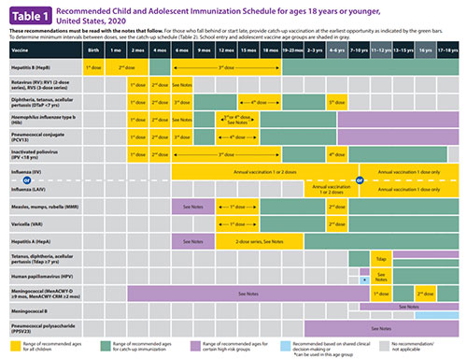
https://www.cdc.gov/vaccines/schedules/hcp/imz/child-adolescent.html

Slide 13
Requirement 1
Physical Exam by PCP, primary care provider.
Explain the following
Diseases that can be prevented and how
Immunization: Diphtheria, Pertussis, Tetanus, Meningitis, Polio, Hepatitis A, Hepatitis B, Haemophilus influenzae type B, Rotavirus, Pneumococcal, Influenza A/B, Varicella, Tetanus, HPV
Good Hygiene: Influenza A/B, Hepatitis A, Common Cold, Norwalk virus
Safe Sex Practices: HIV, Gonorrhea, Chlamydia, Trichomonas, Hepatitis B/C, Syphilis
Avoid Drugs, Do Not Share Needles: HIV, Hepatitis B/C

Slide 14
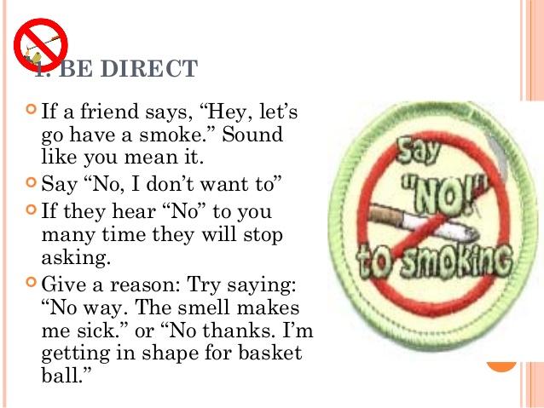
Requirement 1
Tobacco
https://youtu.be/Y18Vz51Nkos

Slide 15
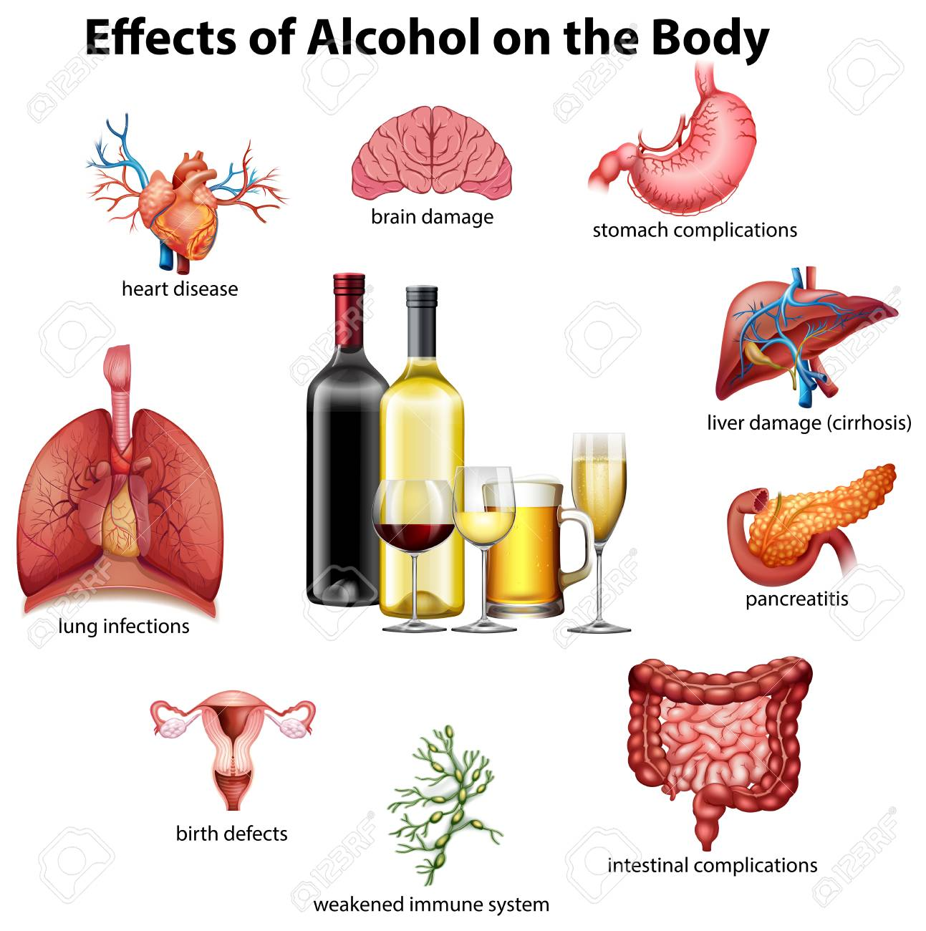
Requirement 1
Alcohol
https://youtu.be/gCrmFbgT37I

Slide 16
Requirement 1
Drugs
Prescription vs Illicit
https://youtu.be/yjAKas1kuqs

Slide 17
Requirement 1
Peer pressure
Boredom
Experimentation
Escaping problems
False sense of “adulting”
https://youtu.be/_NUo_52vkkg

Slide 18
Requirement 1
Physical Exam by PCP, primary care provider.
Explain the following
Seven warning signs of cancer
Change in bowel or bladder habits (colorectal)
Sore that does NOT heal on skin or in mouth
Unusual bleeding or discharge from rectum/bladder (colorectal, prostate, bladder)
Thickening of breast tissue, new lump in breast or lump in testes
Indigestion or trouble swallowing (mouth, throat, esophagus, stomach)
Changes to moles or warts (skin)
Nagging cough or hoarseness that persists for 4-6 weeks (lung or throat)

Slide 19
Requirement 1
Physical Exam by PCP, primary care provider.
Explain the following
Youth risk factors that affect cardiovascular fitness in adulthood
Obesity*
Sex (males at higher risk)
High blood pressure**
High cholesterol**
Diabetes
Smoking*
Lack of exercise*
Family history of heart disease
*Modifiable risk **Possibly modifiable risk with diet/exercise

Slide 20
Requirement 1
Dental Exam
Proof that teeth have been checked
Tell how to care for your teeth
Nutritious diet that is low in simple sugars (simple carbohydrates)
Brush and Floss teeth at least 2x daily for 2 mins., and after meals
Brush teeth away from gums with a small, firm soft bristle toothbrush
Fluoride treatments or treated drinking water
Dental checkups every 6 months
Braces? to straighten your bite to prevent unnecessary wear/tear on teeth

Slide 21
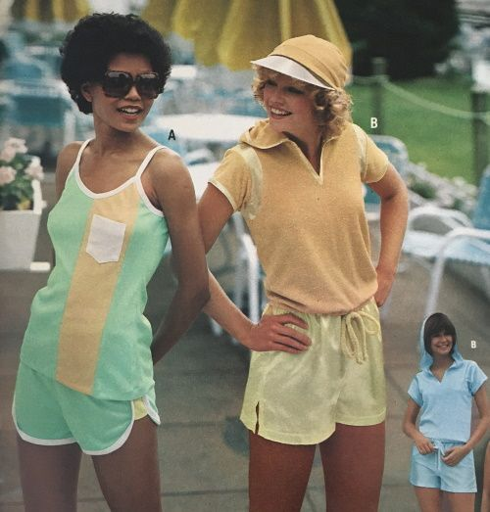
Requirement 2
Explain what personal fitness means to you
Components of personal fitness
Reasons for being fit in all components
What it means to be mentally healthy
What it means to be physically healthy
What it means to be socially healthy. Discuss your activity in the areas of healthy social fitness
What can you do to prevent social, emotional, or mental problems

Slide 22
Personal Fitness
Fitness
Capacity to achieve the best quality of life
Active process through which people become aware of and make choices toward a more successful existence
Personal Fitness
Individual effort and desire to be the best version of yourself
Body- physical health, nutrition, athletic prowess
Mind- mental willpower and alertness, emotional balance, and social skills
Spirit - faith, core values, how to care for yourself and help others

Slide 23
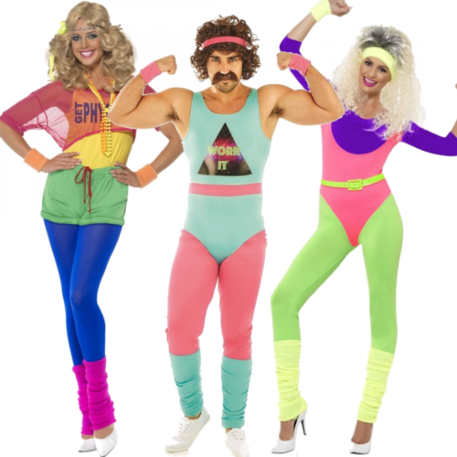
Healthy Personal Fitness
Feel energetic
Look healthy
Have confidence
Endurance

Slide 24
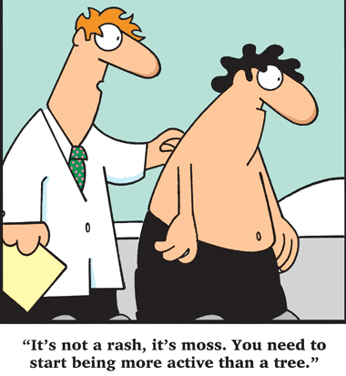
Poor Personal Fitness
Obesity
Short of breath when doing something active, and poor muscle tone
Persistent fatigue
Often feeling pressured, tense, stressed out
Frequent colds, flu, headaches, aches and pains, skin disorders
Depression, anxiety, sleeplessness

Slide 25
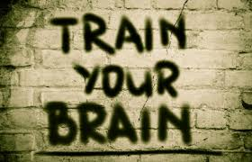
Mental Fitness
Being “mentally awake”
Do well in school, in your future career, solve daily problems
Keep your mind strong and alert
Socially engaged with family and friends

Slide 26
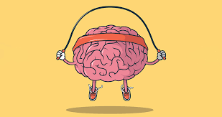
Mental Fitness
Make up jokes
Study a foreign language
Do math problems in your head
Learn something new
Do crossword puzzles, word games, brain teasers
Memorize scenes from movies, lyrics from songs, poems
Teach a skill to another person
Play memory games
Imagine 10 new uses for a familiar object
Draw pictures from memory

Slide 27
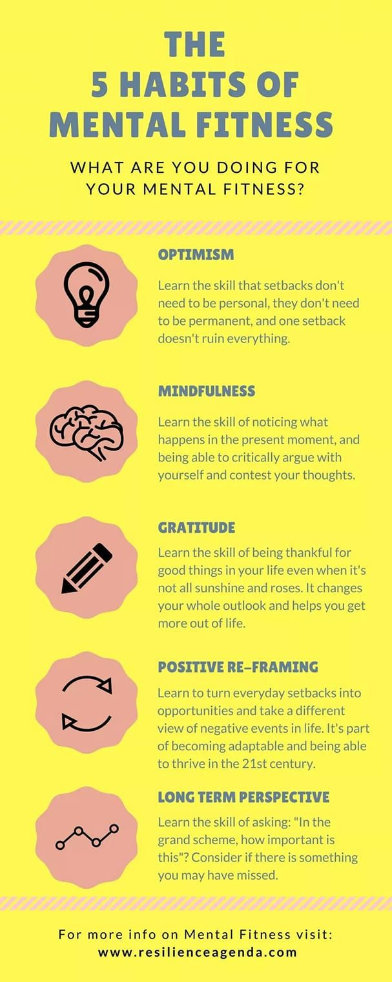
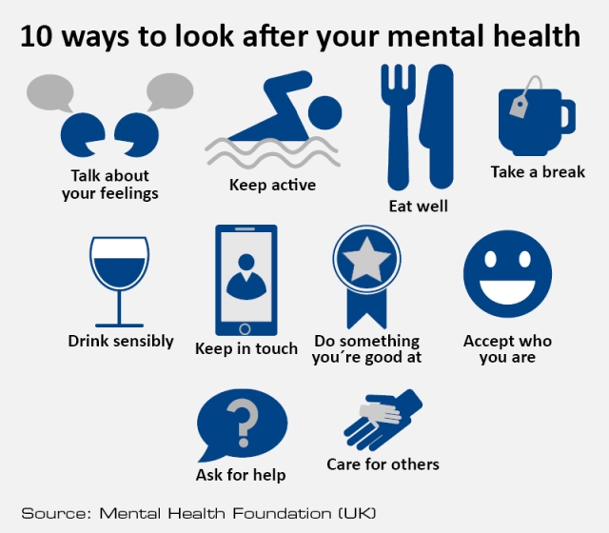
kkjbkjbbjbjbjbjbjbj

Slide 28
Spiritual Fitness
Being “morally straight”
Ethical behavior
Governed by the values of your religion/spiritual tenets, family, community
Responsible self-directed behavior
Doing the right thing even when no one is watching

Slide 29
Priority Health Risk Behaviors & Health Outcomes
https://www.cdc.gov/healthyyouth/data/yrbs/reports_factsheet_publications.htm
https://nccd.cdc.gov/Youthonline/App/Results.aspx?TT=G&OUT=0&SID=HS&QID=QQ&LID=ST&YID=2019&LID2=XX&YID2=2019&COL=T&ROW1=N&ROW2=N&HT=QQ&LCT=LL&FS=S1&FR=R1&FG=G1&FA=A1&FI=I1&FP=P1&FSL=S1&FRL=R1&FGL=G1&FAL=A1&FIL=I1&FPL=P1&PV=&TST=True&C1=ST2019&C2=XX2019&QP=G&DP=1&VA=CI&CS=Y&SYID=&EYID=&SC=DEFAULT&SO=ASC&PF=1

Slide 30
Priority Health Risk Behaviors & Health Outcomes
Behaviors that contribute to the leading causes of mortality and morbidity
Unintentional injuries and violence
Unhealthy sexual behaviors
Alcohol and other drug use
Tobacco use
Unhealthy dietary behaviors
Inadequate physical activity
Obesity
Asthma
Other priority health issues

Slide 31
Requirement 3
Answer and discuss
Are you living in such a way that your risk of preventable diseases is minimized?
Are you immunized/vaccinated according to the advice of your PCP?
Define a nutritious, balanced diet and why it is important.
Are your body weight and composition what you would like them to be, and do you know how to modify them safely through exercise, diet, and lifestyle?
Are you free from habits relating to poor nutrition and the use of alcohol, tobacco, drugs, and other practices that could be harmful to your health?
Do you participate in a regular exercise program or recreational activities?

Slide 32
Requirement 3
Answer and discuss
What are the advantages of a full night’s sleep?
Are you actively involved in the religious organization or spiritual practices of your choice?
Do you spend quality time with your family and friends in social and recreational activities?
Do you support family activities and efforts to maintain a good home life?

Slide 33
Requirement 4
Explain the following about physical fitness
Components of physical fitness
Your weakest and strongest component of physical fitness
The need to have a balance in all four areas of physical fitness
How the components of personal fitness relate to Scout Law/Scout Oath

Slide 34
Requirement 4
Cardiovascular and pulmonary endurance
Muscular strength and endurance
Flexibility
Body composition

Slide 35
Requirement 4

Slide 36
Requirement 4
Personal fitness goals: achievable with actionable outcomes
Physically fit: plenty of exercise, limiting screen time, maintaining nutritious diet, enough sleep, preventative care against illness/injury
Fitness
Aerobic: raises your heart rate and increases effort to breath: hiking, cycling, running, walking
Muscle strengthening: makes your muscles work harder than normal: sit ups, pushups, rock climbing, games like tug of war
Bone strengthening: promote bone growth and maintenance by exerting force on them: running, jumping rope, sports like basketball, tennis, volleyball

Slide 37
Requirement 4
Stretching/Warming Up
Increases flexibility and decreases injury as it warms up muscles, tendons/ligaments
5-10 mins: jogging, jumping jacks
5-10 mins: stretches
Thigh stretch
Achilles tendon/Calf stretch
Straddle stretch
Lower back stretch
Shoulder stretch
Back-saver Sit and Reach
Measures flexibility

Slide 38
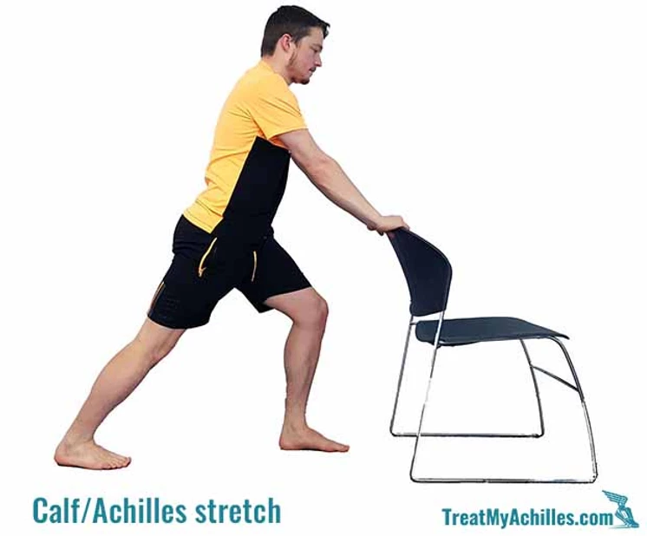
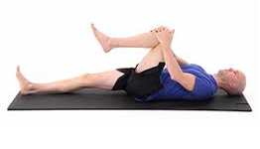
Shoulder Stretch
Thigh Stretch
Straddle Stretch
Achilles Tendon/Calf Stretch
Lower Back Stretch

Slide 39
Requirement 4
Aerobic
means "with oxygen," which means that breathing controls the amount of oxygen that can make it to the muscles to help them burn fuel and move. Improves cardiovascular conditioning. Decreases risk of heart disease
One Mile Walk/Run
Strengthens heart, lungs, and muscles of legs/hips
Biking
Swimming
Rowing
Skating.
Cross-country skiing
Exercising on a stair-climber or elliptical machine
Dancing or Zumba
Jumping jacks and Burpees

Slide 40
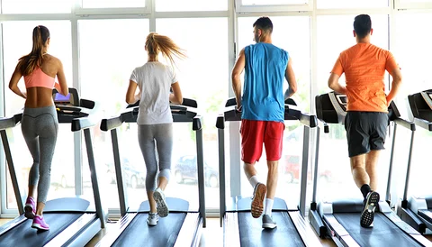
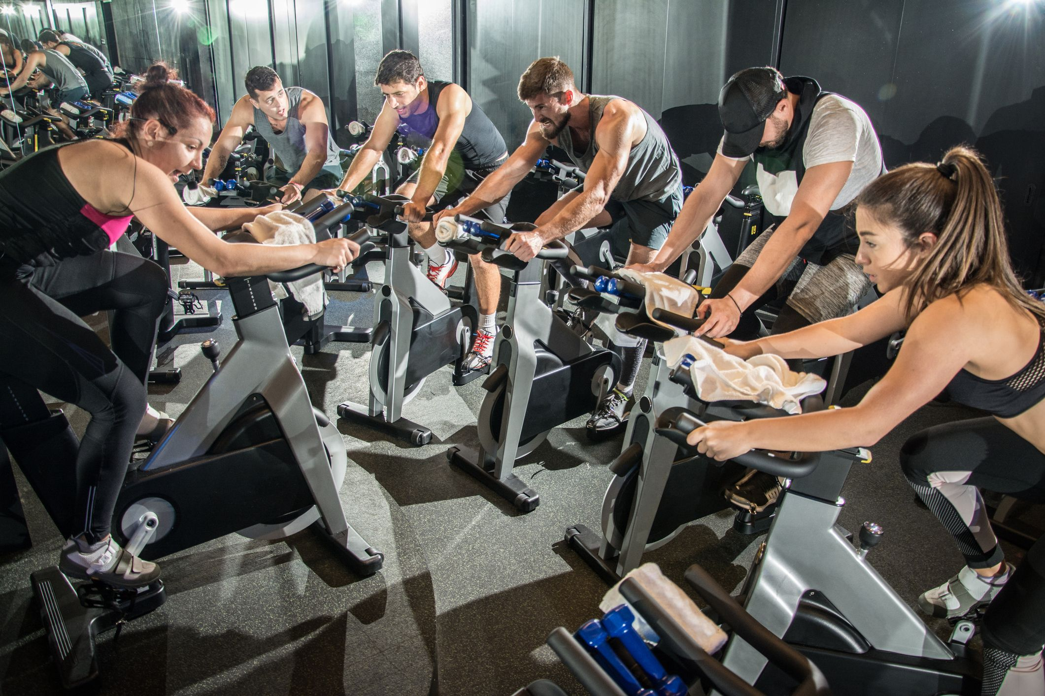
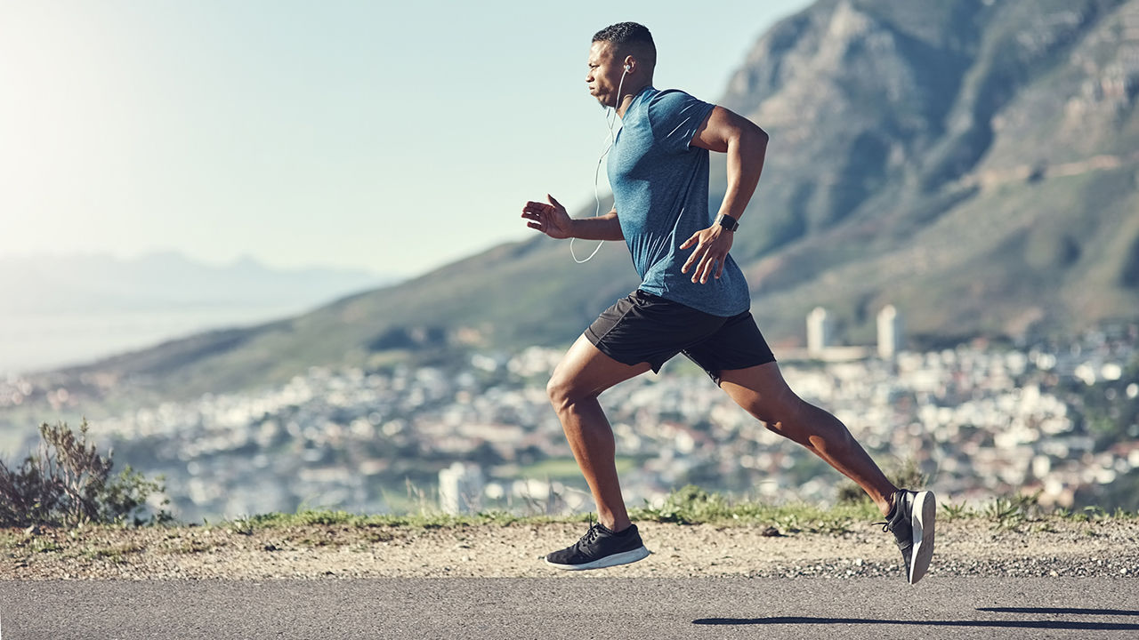

Slide 41
Requirement 4
Strength Building
Recommended 3 sets of each 3-4 x/week
Pushups
Build muscles of arms, chest, shoulders
Situps
Strengthen the muscles of the abdomen
Curl-ups
Situps that are protective of your spine
One Mile Walk/Run
Strengthens heart, lungs, and muscles of legs/hips

Slide 42
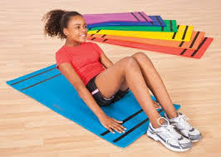
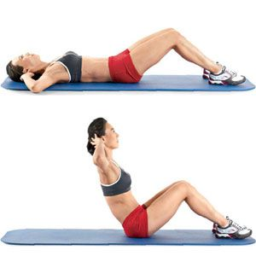
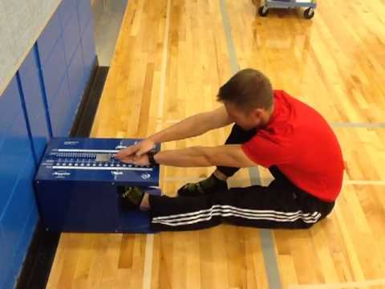

Slide 43
Requirement 5
Explain the following about nutrition
The importance of good nutrition
What good nutrition means to you
How good nutrition is related to the other components of personal fitness
The three components of maintaining a healthy weight

Slide 44
Requirement 5
Nutritious Food
Serve as a source of energy
Build/repair your body
Provide required vitamins, minerals, and fiber

Slide 45
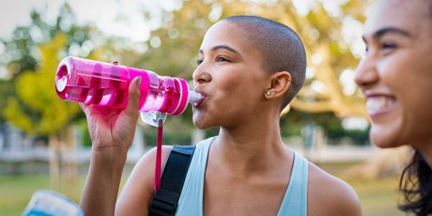
Requirement 5
Hydration
WATER
Drink enough to quench thirst and have yellow/clear urine

Slide 46
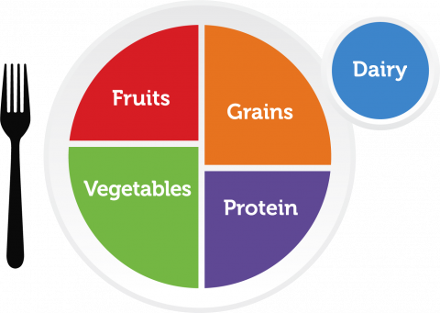
Requirement 5
MyPlate: Homepage
Food Groups
Grains (orange)
Vegetables (green)
Fruits (red)
Dairy (blue)
Protein (purple)
Fats and Oils

Slide 47
Requirement 5
Food Groups
Grains
Cereals, breads, crackers, rice, pasta
Carbohydrate
Whole grain foods: oatmeal, whole grain bread, brown rice
More fiber, vitamins, minerals
Highly processed foods: white bread, white rice, sugar breakfast cereals
Vegetables
Broccoli, spinach, leafy greens
High in vitamin A, vitamin C, and many other minerals
Carrots, sweet potatoes, other orange veg
High in vitamin A
Eaten raw, steamed, microwaved

Slide 48
Requirement 5
Food Groups
Fruits
Apples, oranges, bananas, berries
Dairy
Low-fat milk, yogurt, pudding, cheese, ice cream
Rich in vitamins and calcium, important for bone strength
Protein
Fish, poultry, beef, pork
Baked, broiled, grilled
Beans, legumes: peas, lentils
Includes fiber, other vitamins and minerals
Nuts and seeds

Slide 49
Requirement 5
Food Groups
Fats and Oils
Unsaturated vs Saturated
Prefer fats from fish, nuts, and vegetable oils
Minimal solid fats: butter, margarine, shortening, lard

Slide 50
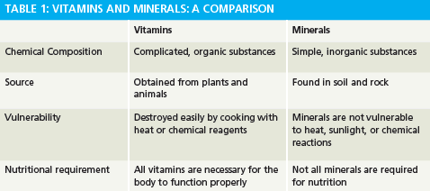

Slide 51
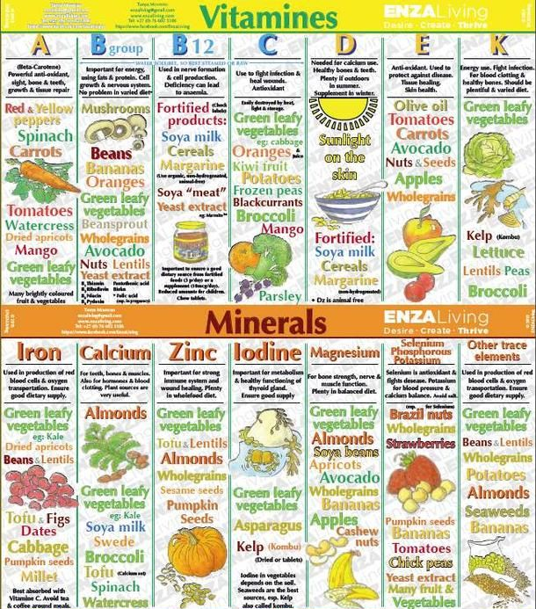

Slide 52
Notes:
Vitamin A: Milk, eggs, orange fruits and green veggies. : Prevents eye problems, keep skin healthy
Vitamin B: Meat, eggs, diary, enriched products, legumes (pulses or beans), whole grains, potatoes, bananas, chili peppers, tempeh, nutritional yeast, brewer's yeast, and molasses: Responsible for cell metabolism and red blood cell creation
Vitamin C: Citrus fruits, strawberries, peppers, spinach, broccoli, tomatoes: Strengthens bones, teeth, blood vessels, and gums
Vitamin D: Fortified milk, egg yolks, oily fish (salmon/cod), sunlight: Strengthens bones, immunity, hormone regulation
Calcium: MIlk, dairy, dark leafy veggies: Strengthens bones/teeth
Iron: Red meat, beans, raisins, black strap molasses, green leafy veggies: Improves transport of oxygen on red blood cells -prevents weakness, fatigue, lightheadedness, organ failure
Potassium: Potato skin, broccoli, green leafy veggies, citrus fruits, bananas, legumes (peas/lima beans): Improves heart, muscle, nervous system function, balance of water in body

Slide 53
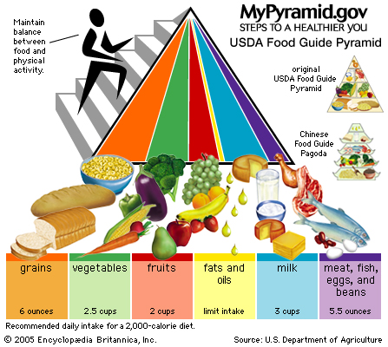

Slide 54
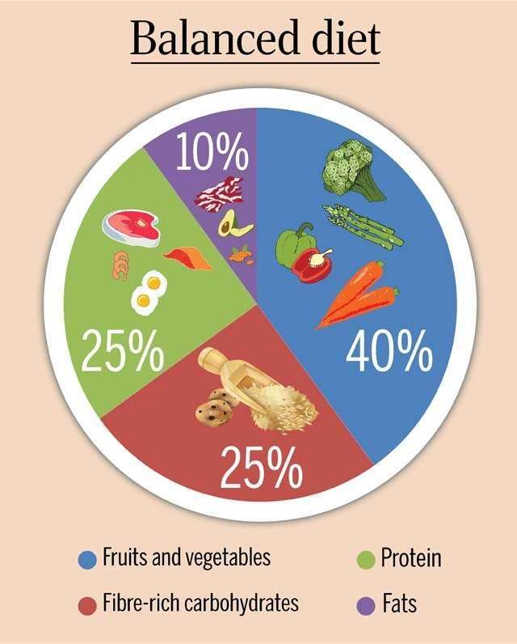

Slide 55
Requirement 5
Empty Calories
Calories without nutritional benefit
Sugar
Processed, High-fructose corn syrup
Limit

Slide 56
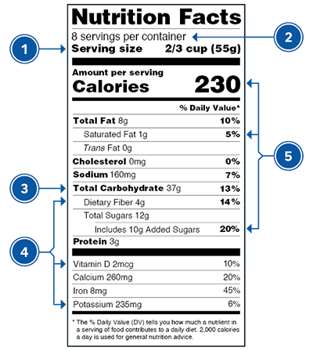
Requirement 5
Reading a Food Label
https://www.fda.gov/media/135197/download
https://www.youtube.com/watch?v=OWMSJqnYFMY&feature=youtu.be

Slide 57
Requirement 5
Food Allergies
Wear a medical alert bracelet
Carry an epipen at ALL TIMES
Seek help immediately if suspected/actual reaction occurs
Limit exposure to allergens by eating in separate location or bringing your own food
Never trade food with others
Never eat anything with unknown ingredients
Read food labels and check ingredients with parent, guardian, leader if questionable
Do not isolate if symptoms begin. Seek help IMMEDIATELY
Special Diets
Religious: Kosher or Halal
Ethical, Health reasons, or Personal choice: Vegan, Vegetarian, Pescetarian, Keto, Raw, Paleo, Heart Healthy (DASH diet or Mediterranean diet), Diabetic

Slide 58
Requirement 5
Maintain a healthy weight
Eat a balanced diet with adequate calories
Serve small or appropriate sized servings
Regular exercise

Slide 59
Requirement 5
BMI
https://youtu.be/z_3S2_41_FE

Slide 60
Requirement 6
Complete the aerobic fitness, flexibility, and muscular strength test. Record results and ID areas where you need to improve. (Before req 7&8)
Track what you eat and drink for 3 days. ID three healthy eating goals you want to achieve.

Slide 61
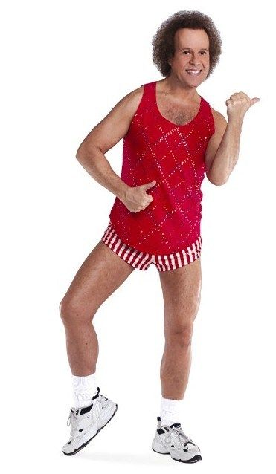
Requirement 7
Outline a 12-week physical fitness program using the results of your fitness tests. Include endurance, intensity, and warm up guidelines in your program. Counselor and/or parents must approve program.

Slide 62
Requirement 7
Warm-up
Aerobic Exercises
Strength Exercises
Flexibility Exercises
Cool-down

Slide 63
Requirement 8
Complete physical fitness program created in Req 7.
Keep a log of fitness activity: how long you exercised, how far you ran/swam/biked, how many exercise reps were done, exercise heart rate, etc.
Repeat aerobic fitness, muscular strength, and flexibility tests every 4 weeks, record results
After 12 weeks, repeat all required activities in each of the 3 test categories, record results, show improvement.
Discuss the meaning and benefit of your experience, and describe your long-term plans re: personal fitness

Slide 64
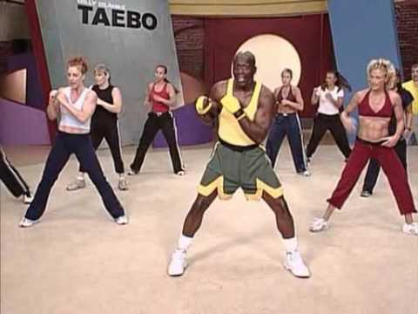
Requirement 9
Three career opportunities in personal fitness.
Pick one career and discuss the education, training, and experience required. Explain why this profession interests you.

Slide 65
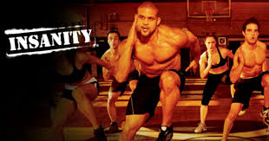
Requirement 9
Exercise Physiologist
Personal Trainer
Group Fitness Instructor
Kinesiologist
Dietician
Athletic Coach
Scout
Certified Athletic Trainer
Gym Owner
Physical Therapist
Health & Wellness Coach
Occupational Therapist
P.E. Teacher
Fitness Technology Engineer
Fitness Apparel Designer

Slide 66
Requirement 9
Kinesiologist
Study of human and nonhuman animal-body movements, performance, and function by applying the sciences of Biomechanics, Anatomy, Physiology, Exercise Physiology, Nutrition, and Neuroscience
Education: Bachelors, Masters, Doctorate
Training: College work and on the job training
Experience: Biomechanics and orthopedics; strength and conditioning; sport psychology; physical and occupational therapy; and sport and exercise physiology. Studies of motion tracking systems, electrophysiology of muscle and brain activity. Teach physical education, work as personal trainers and sport coaches, provide consulting services, conduct research and develop policies related to rehabilitation, human motor performance, ergonomics, and occupational health and safety

Slide 67
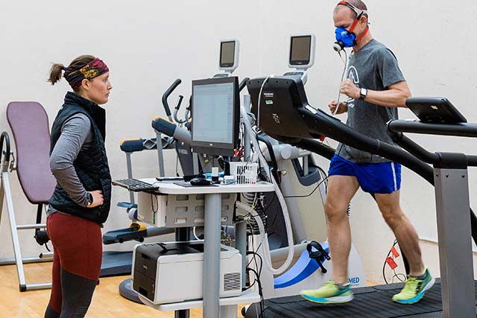

Slide 68
Growth Charts
https://www.cdc.gov/growthcharts/data/set1clinical/cj41c021.pdf
https://www.cdc.gov/growthcharts/data/set1clinical/cj41c023.pdf
https://www.cdc.gov/growthcharts/data/set1clinical/cj41c022.pdf
https://www.cdc.gov/growthcharts/data/set1clinical/cj41c024.pdf

